Slide 1
Kentucky Aviation System Plan and Economic Impact Study Update

Slide 2
Agenda
01
02
03
04
Kentucky AEIS Overview and State of the Industry
Questions?
IMPLAN Modeling
Statewide Findings

Slide 3
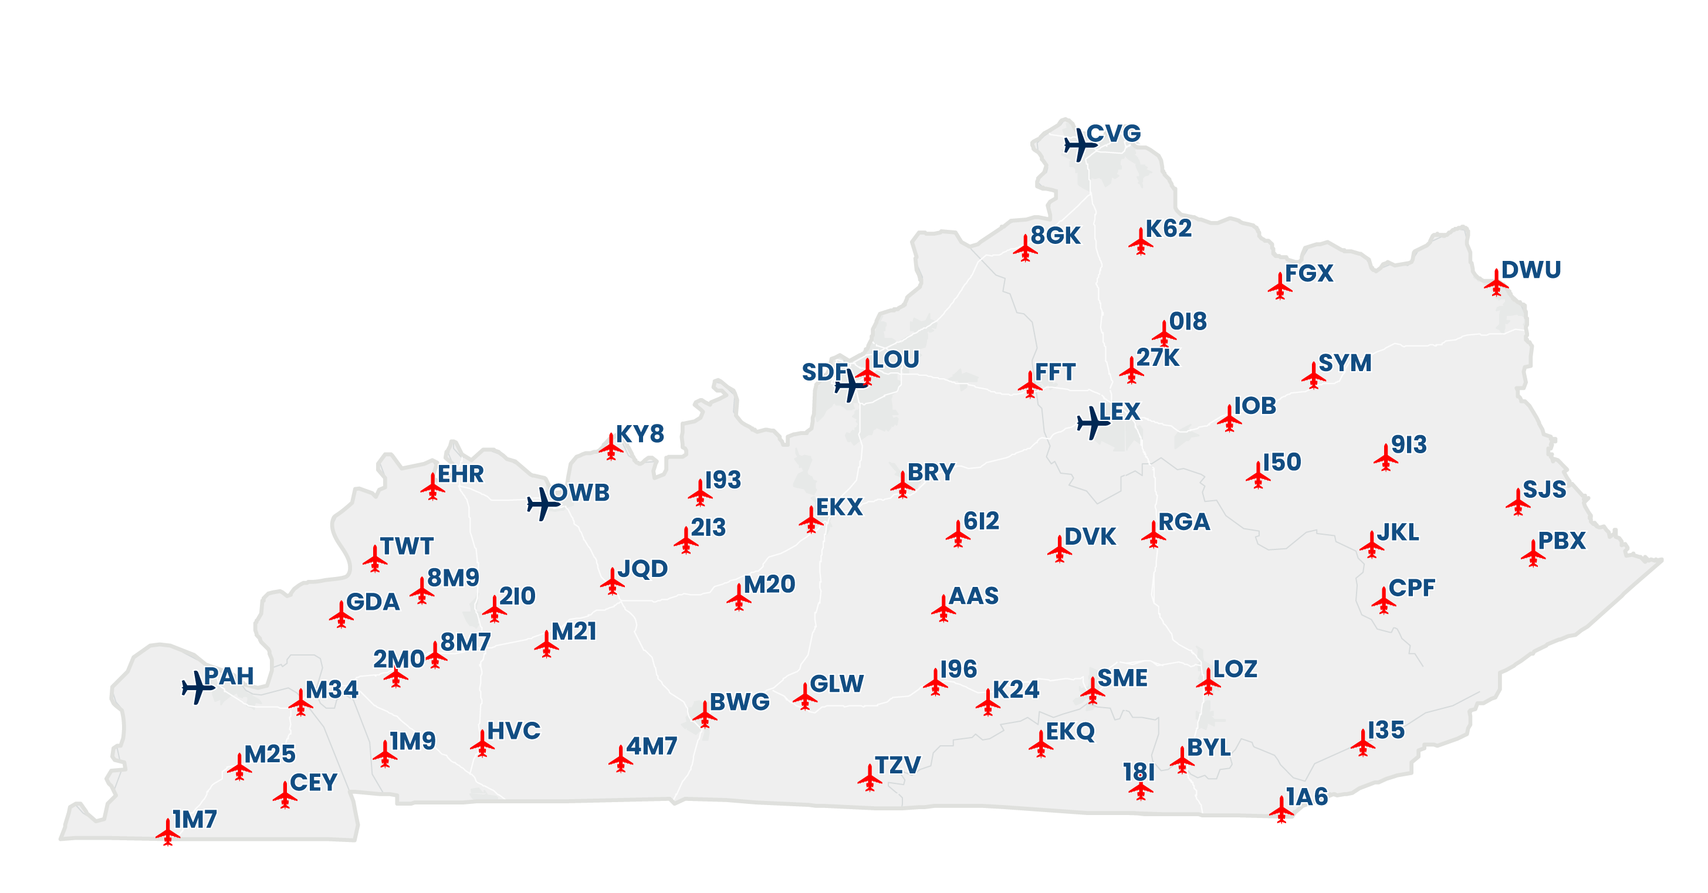

Kentucky AEIS Overview
Site visits wrapped up in September
Out of state passenger surveying completed at three commercial service airports
A total of 1,282 responses collected accounting for 2,580 total passengers
Passive pilot and passenger surveying was conducted at the remaining airports
A total of 80 responses were collected accounting for 94 individuals
Tenant surveying was completed at all study airports
A total of 487 individuals tenants surveyed accounting for 14,223 total employees

Slide 4
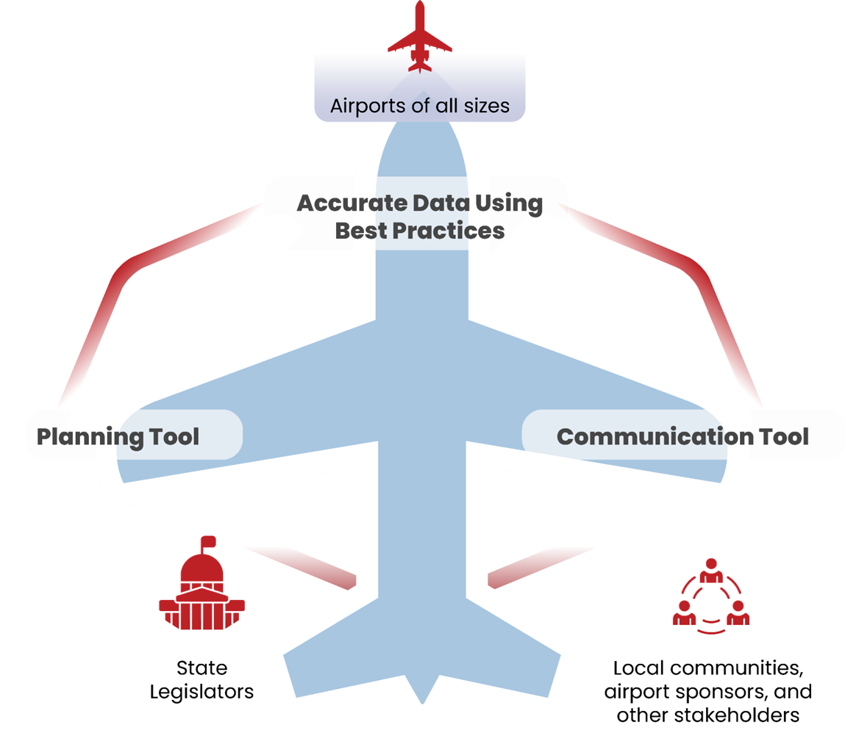
Purpose of the Economic Impact Study
Understand the overall role of aviation in enhancing and supporting Kentucky’s economy
Analyze airport activity to determine real-dollar economic impacts
Convey the importance of Kentucky’s airports to users, communities, and businesses within the state

Slide 5

Project Process

Slide 6




Data Collection – Who Participated?
Airport Administration
Commercial Service Visitors
Airport Tenants
General Aviation Visitors

Slide 7



State of the Industry
2.7 million
Out-of-State Commercial Visitors
582,629
General Aviation (GA) Aircraft Operations
54,667
Employees Working Directly for the Airport or On-Airport Business Tenants

Slide 8
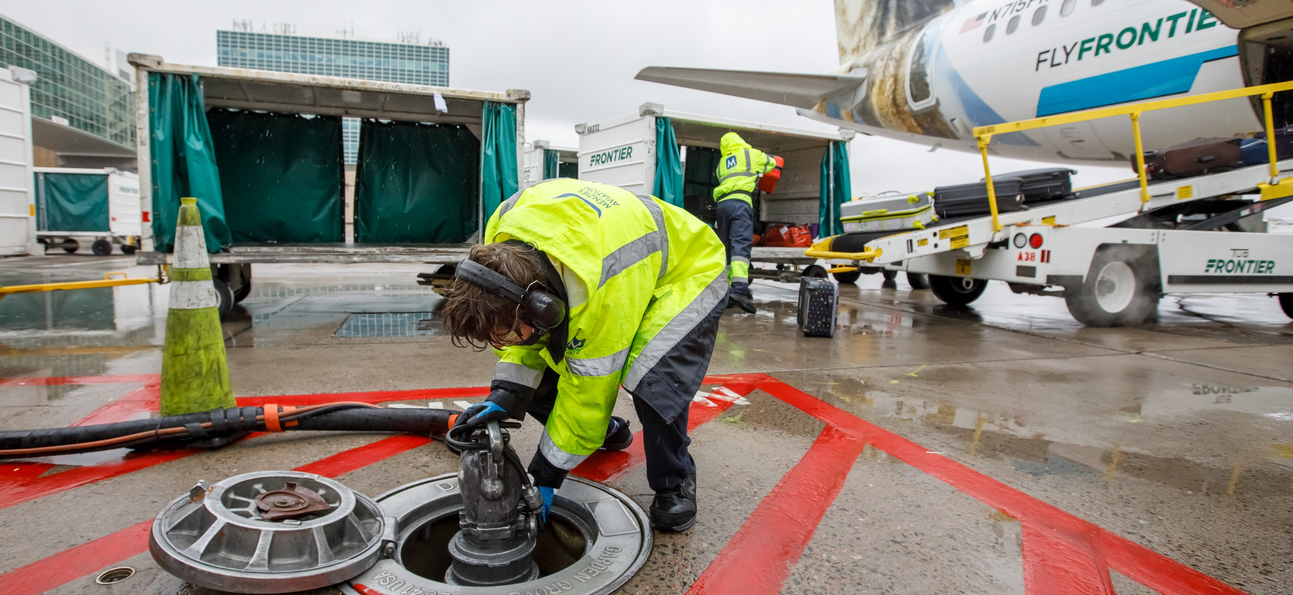









Other Industry Changes
COVID Recovery
Increased Labor Costs
Workforce Shortages
Increased construction material costs
Record Inflation
Notes:
COVID recovery → passenger volumes rebounding; return of business travel; GA activity above pre‑pandemic levels
Increased labor costs → airport operations, ARFF staffing, tenant labor shortages raising operating costs
Workforce shortages → pilots, mechanics, ATC pipeline; airports facing hiring challenges
Increased construction costs → runway/taxiway rehabilitation now significantly more expensive than 2018-era estimates
Record inflation (~25% since 2018) → impacts fuel prices, material costs, and contractor bids

Slide 9
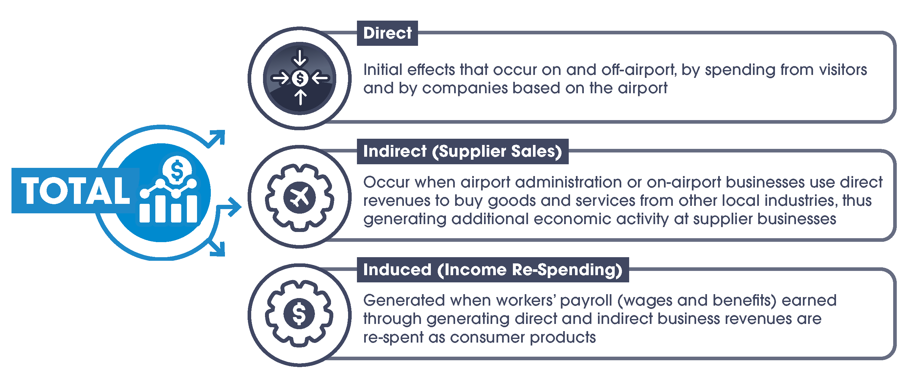
Economic Impact Terms

Slide 10
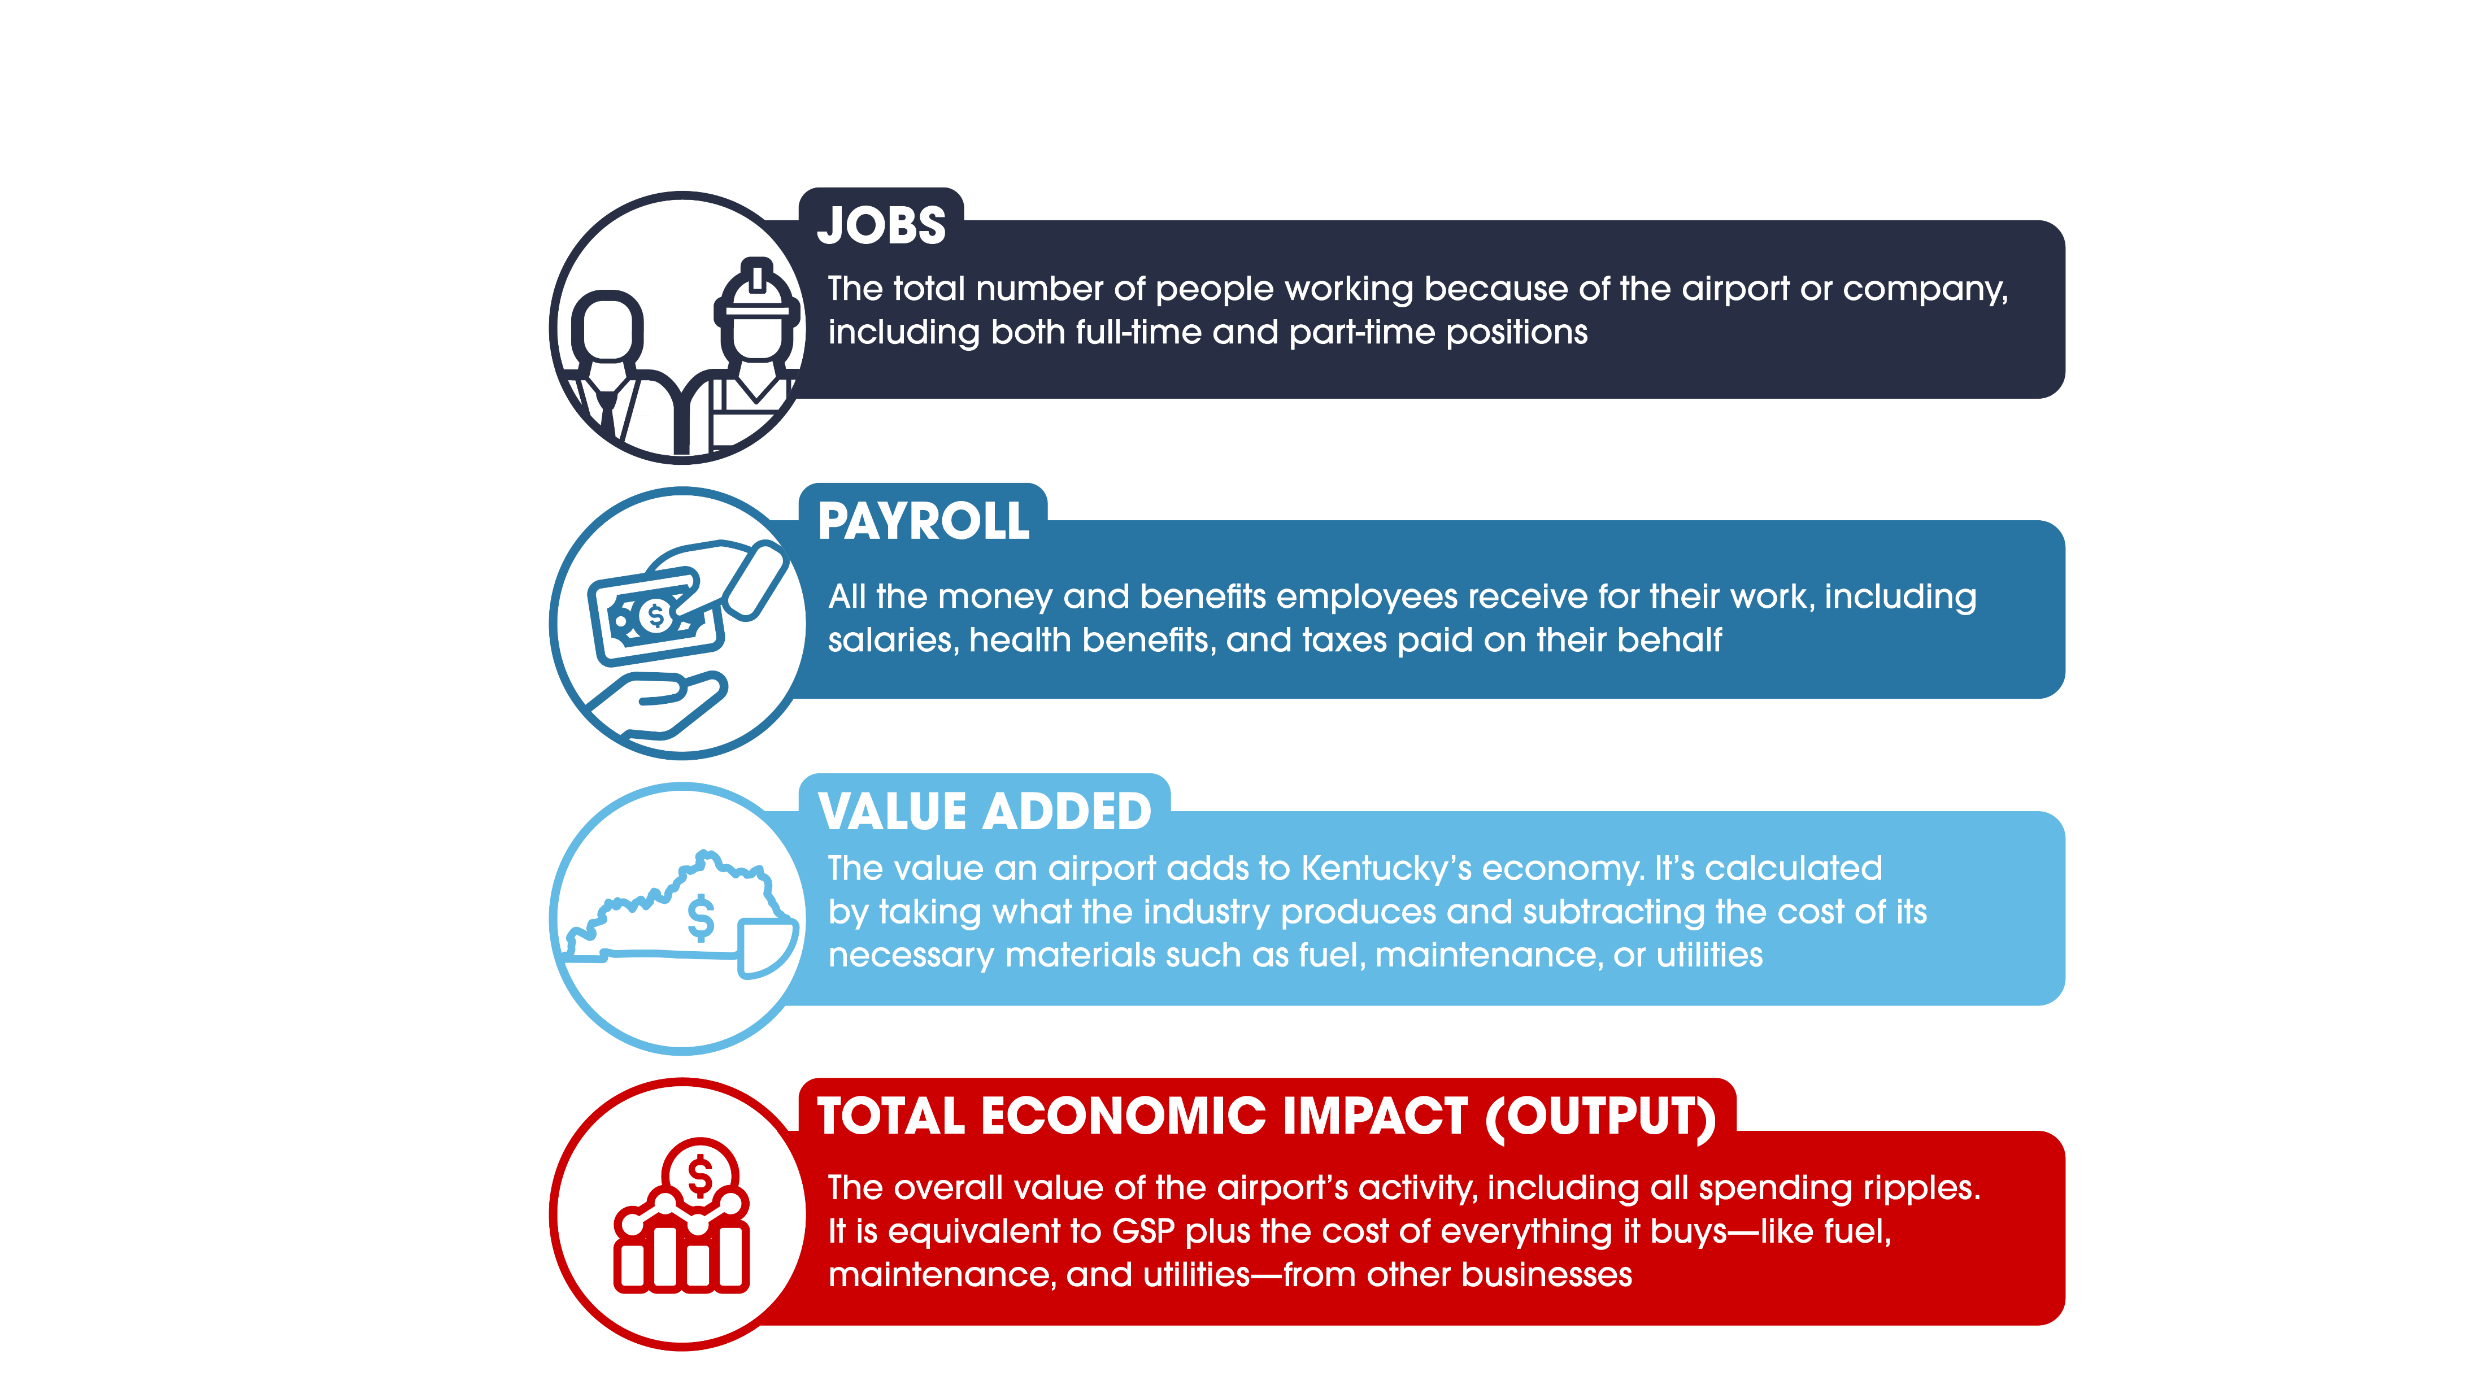
Economic Impact Measures

Slide 11
IMPLAN
Modeling

Slide 12



IMPLAN
Economic Modeling Software
FAA-Approved
Input-Output Model​
Based on Employee Headcount
Generates Direct, Multiplier, and Total Impacts

Slide 13
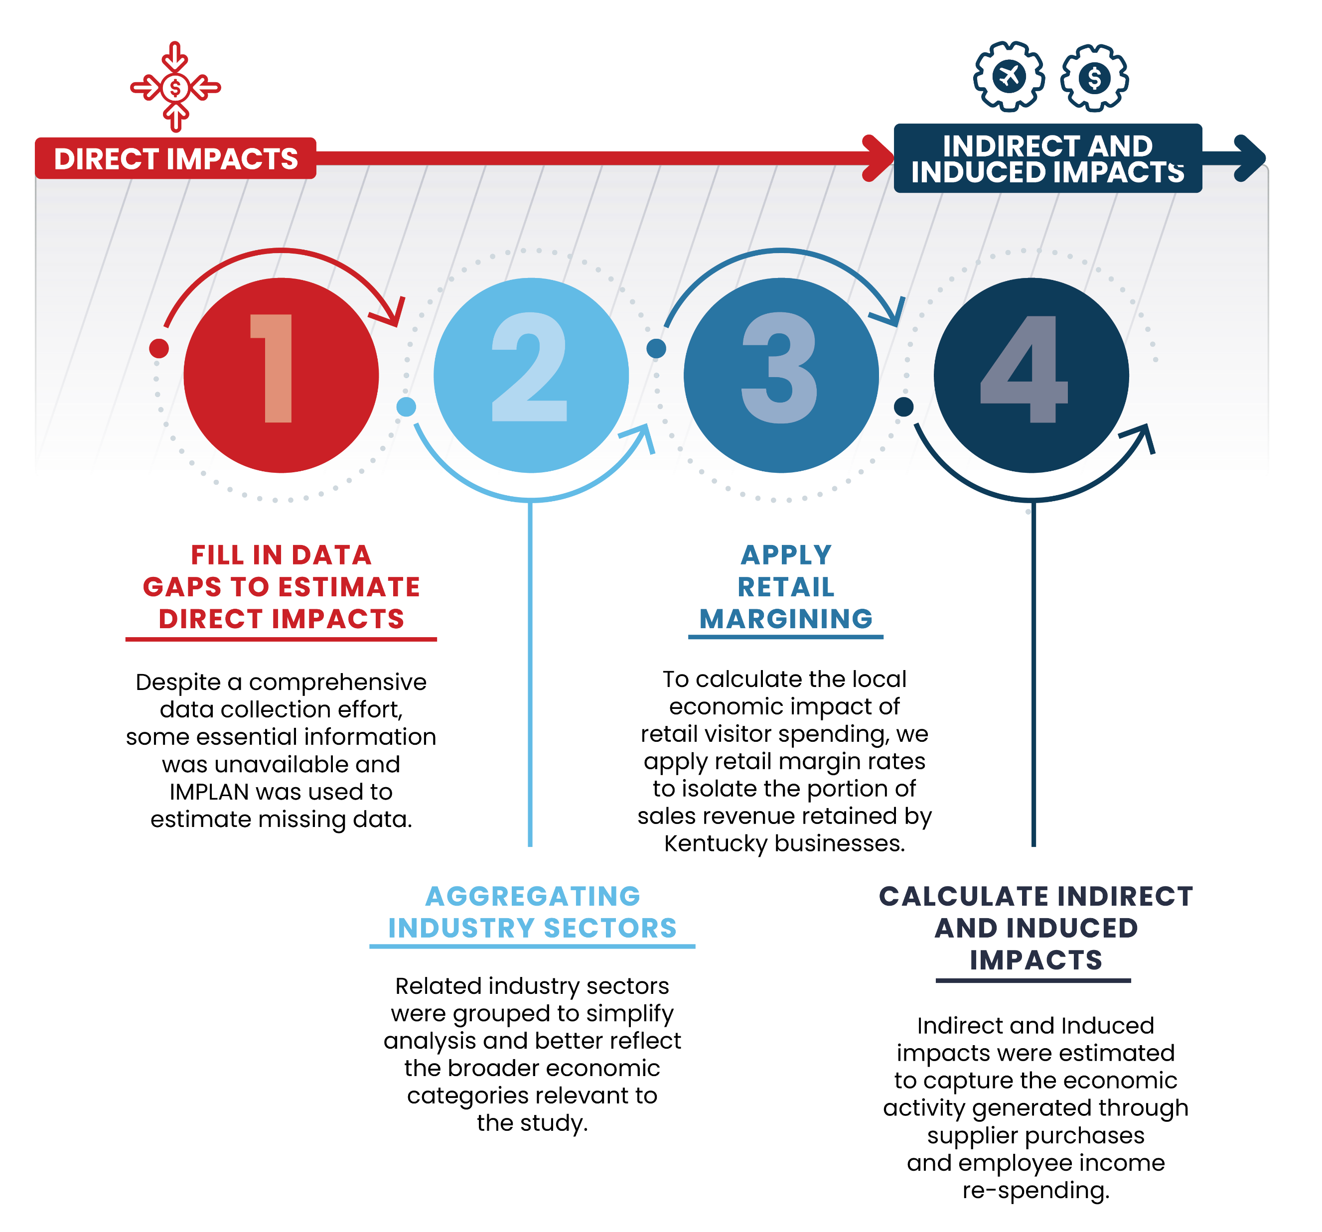

Use of IMPLAN

Slide 14
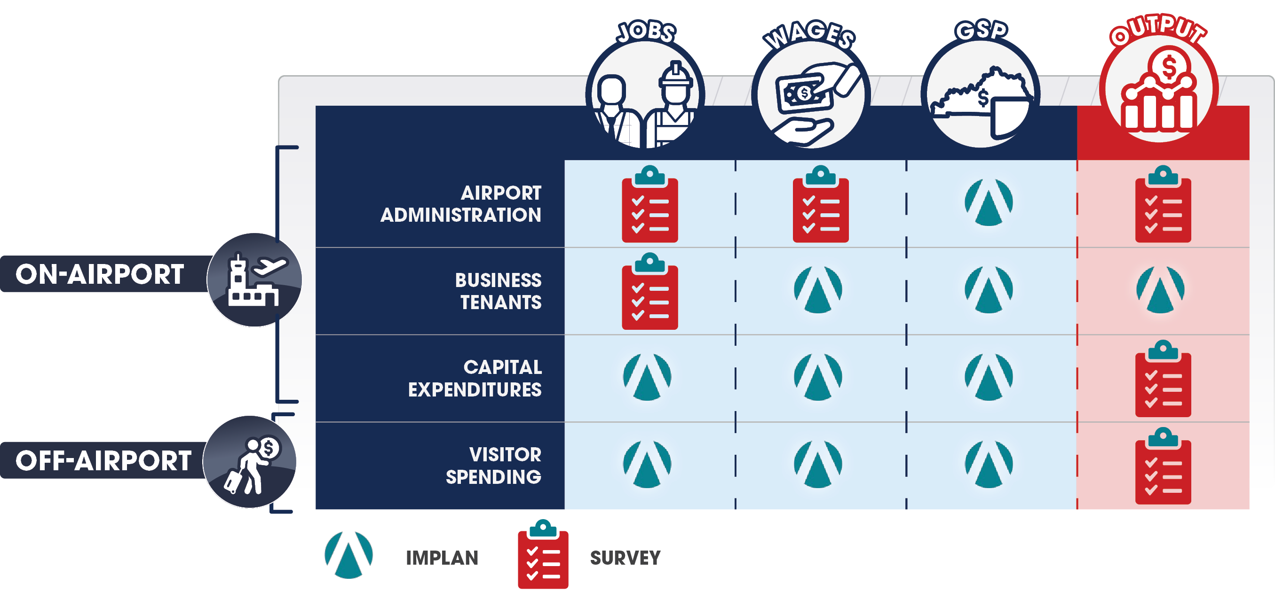
Direct Data Source

Slide 15








IMPLAN Inputs and Outputs
Direct Input
Direct Outputs
Jobs
Payroll per Job
Value Added per Job
Business Revenues per Job
Business Revenues
Jobs per $1M Business Revenues
Payroll per $1M Business Revenues
Value Added per $1M Business Revenues

Slide 16










IMPLAN Modeling Process
Jobs Used as Direct Input
Multiplier Effects
Supplier Sales and Income Re-spending
Total Impacts
Airport Administration
Airport Tenants
Business Revenues Used as Direct Input
Calculated per $1M Direct Business Revenues
Commercial Visitor Spending
GA Visitor Spending
Capital Improvements

Slide 17
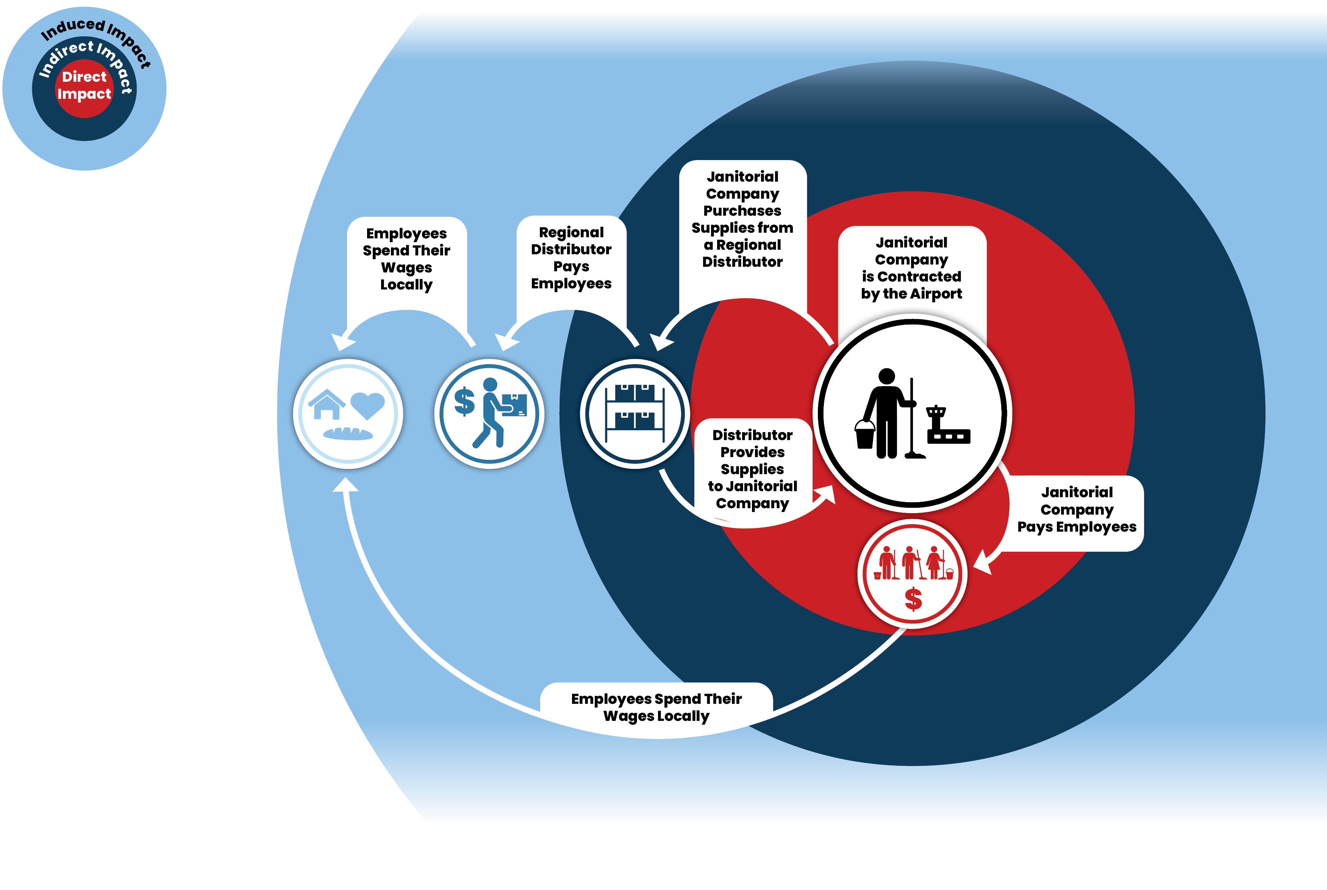
Example: Jobs

Slide 18
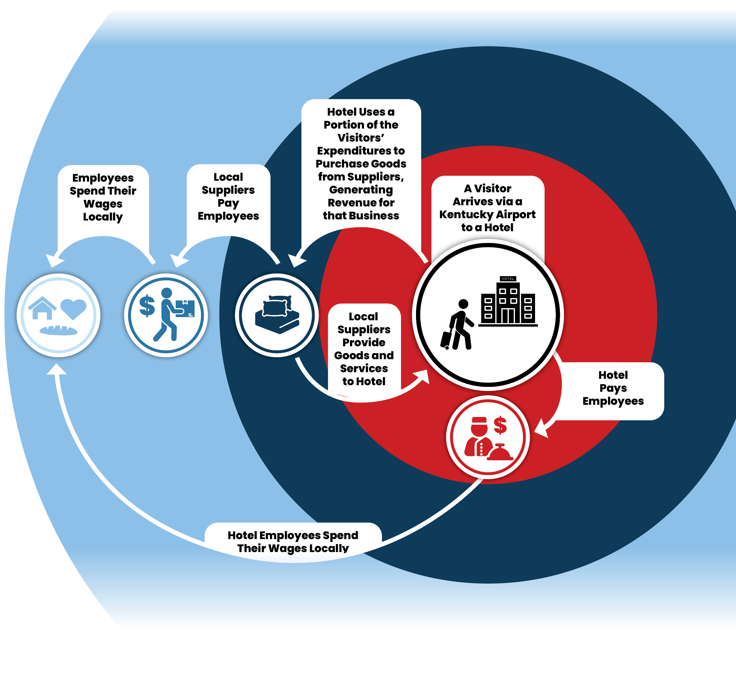
Example: Visitor Spending

Slide 19
Statewide
Findings

Slide 20
$26.5
$26.5
Billion
In Total Economic Impact for Kentucky Airports
Billion

Slide 21






Total Statewide Aviation Impacts
$9.4 Billion
$13.8 Billion
$26.5
Billion
138,000
JOBS
PAYROLL
VALUE ADDED
BUSINESS REVENUES
*Value Added is a separate type of impact that measures the value of goods and services beyond the value of the inputs. If a company sells a product for $100 and the materials used to create that product cost $30, the value added is $70.

Slide 22




General Aviation Impacts
2022
2025
6,154
4,634
JOBS
1,520
2022
2025
$373 Million
$292 Million
PAYROLL
$81 Million
2022
2025
$1.1 Billion
$891 Million
OUTPUT
$209 Million

Slide 23
BWG Bowling Green (Kentucky Regional)
161
$11.9 Million
JOBS
VALUE ADDED
$7.3 Million
$21.3 Million
PAYROLL
BUSINESS REVENUES

Slide 24
I93 Breckenridge County (Kentucky Basic)
16
$1.3 Million
JOBS
VALUE ADDED
$686,000
$2.3 Million
PAYROLL
BUSINESS REVENUES

Slide 25
I96 Columbia Adair County (Kentucky Unclassified)
5
$412,000
JOBS
VALUE ADDED
$243,000
$842,000
PAYROLL
BUSINESS REVENUES

Slide 26





Commercial Service Impacts
9,102,736,269
2022
2025
89,000
133,000
JOBS
44,000
2022
2025
$6 Billion
$ 9.1 Billion
PAYROLL
$3. 1 Billion
2022
2025
$18.5 Billion
$25.6 Billion
OUTPUT
$7.1 Billion

Slide 27
Total Economic Impact Changes from 2022 KTC Study
2022
2025
95,000
138,000
JOBS
43,000
2022
2025
$6.4 Billion
$9.4 Billion
PAYROLL
$3 Billion
2022
2025
$19.6 Billion
$26.5 Billion
OUTPUT
$6.9 Billion

Slide 28
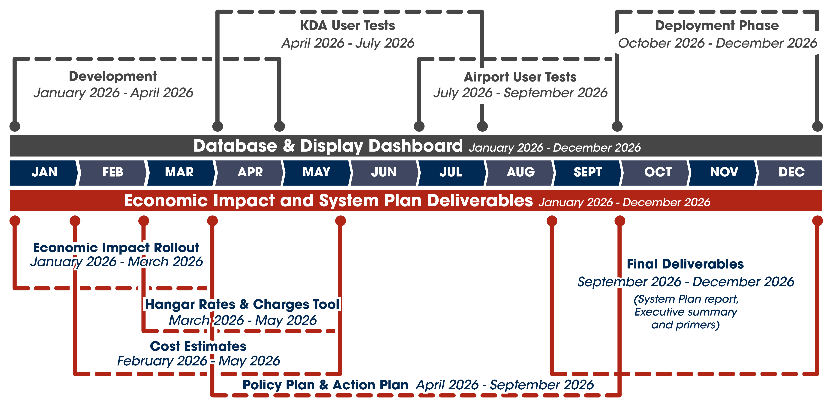
Deliverables Timeline

Slide 29
Questions?

